Slide 1
Title
Name
Titles

Slide 2
Introduction
Related Works
Proposed Approach
Experimental Details
Results and Analysis
Conclusion
Introduction
Problem – Can we accurately predict the direction of the stock market?
Value – Profitable trading algorithm.
Method – Arima forecasting method implemented in R.
Finding -

Slide 3
Introduction
Related Works
Proposed Approach
Experimental Details
Results and Analysis
Conclusion
Related Works
Contributions
Limitations

Slide 4
Introduction
Related Works
Proposed Approach
Experimental Details
Results and Analysis
Conclusion
Proposed Approach
One slide explaining your process/method
Use the ARIMA forecasting method to predict the price direction of the S&P 500 stock market index tomorrow.0
Check if dataset is stationary by analyzing the coefficients of correlation between days in our timeseries.
Use differencing method and take the log to convert our timeseries into a stationary dataset of log returns.
Train ARIMA model on the series and predict ahead 1 day log return values.
Classify model output results where prediction matches actual data as 1, 0, -1. Where 1 means BUY and -1 means SELL. 0 mean do nothing.
Use model to predict tomorrow's price direction on up to date price data.
Retire.
  To use arima, we need a stationary dataset.
  Apply differencing method to take difference of each consecutive day in the timeseries data.
Train the model on 5 years of daily closing price data of the SPY etf, a proxy for the index.
To apply ARIMA, we need a stationary dataset. I take the difference Therefore I take the log of the stock price change

Slide 5
Introduction
Related Works
Proposed Approach
Experimental Details
Results and Analysis
Conclusion
Experimental Details
Data (if you collected it)
I collected 5 years of closing daily price data for the SPY exchange traded fund, a proxy for the S&P 500 market index.
R Packages:
  quantmod, dplyr, forecasting, stats, xts
Specific details of your project that may not fit in the approach or results section

Slide 6
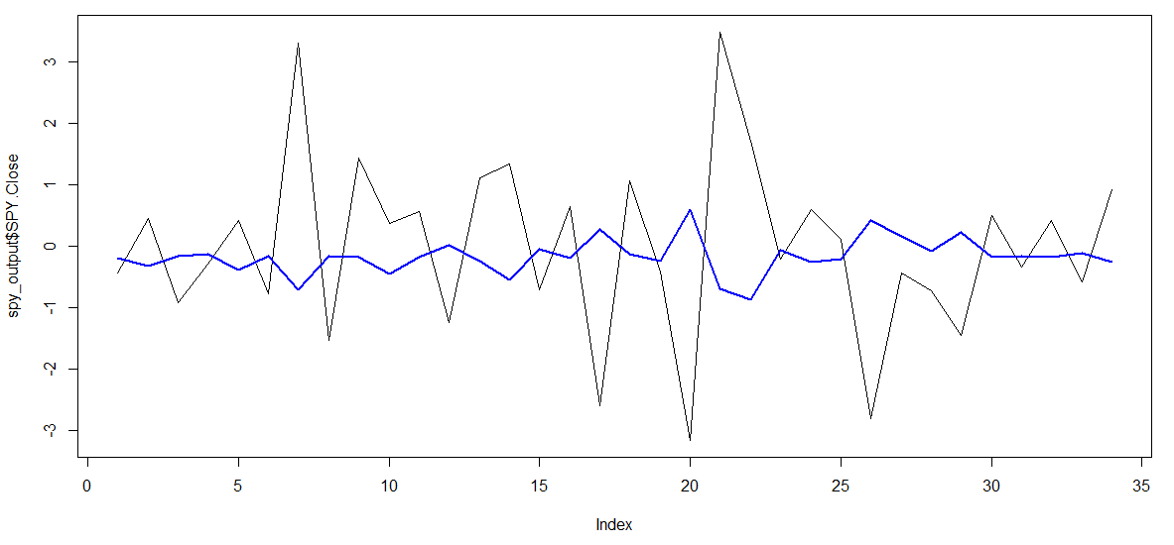
Introduction
Related Works
Proposed Approach
Experimental Details
Results and Analysis
Conclusion
Results and Analysis
Focus on the conclusions/findings and include data as needed to support

Slide 7
Introduction
Related Works
Proposed Approach
Experimental Details
Results and Analysis
Conclusion
Conclusion
Emphasize the novelty of your work
Limitations
Future Work
End on a positive note

Slide 8
Title
Name
Titles

